Slide 1
NASTP INSTITUTE OF INFORMATION TECHNOLOGY
AI335L — Deep Learning Lab | BS Computer Science | Spring 2024
Sketch-to-Face
Image Synthesis
Using Pix2Pix Conditional GAN & ResNet-50 Transfer Learning
"Turning forensic sketches into photorealistic faces through end-to-end deep learning."
Moazzam Sharif (Team Lead) • Bilal Asif (Data Analyst) • Muaz Ahmed (Testing & Deployment)
Instructor: Lecturer Muhammad Haseeb | Submission: June 2026

Slide 2
Project Overview
What We Built
25.4%
53.8M
End-to-end deep learning pipeline: forensic sketch → photorealistic face
Six development phases from problem formulation to deployment
Trained on 25,000 filtered CelebA images at 256×256 resolution
Final model: ResNet-50 encoder + StyleGAN2 decoder (pSp framework)
Deployed as Streamlit web application with Docker containerisation
Public GitHub repository with full reproducibility documentation
L1 Improvement
vs. Scratch Baseline
Parameters
(ResNet-50 TL)
0.2960
6
Final Test L1
(Phase 4)
Development
Phases
github.com/BILAL-ASIF-github/Sketch-to-Face-Image-Synthesis
Public Repository • Reproducible Pipeline • Docker Ready

Slide 3
Project Roadmap — Six Phases
1
2
3
4
5
6
Formulation
EDA & Baseline
pSp Architecture
Transfer Learning
Evaluation
Deployment
Problem statement,
literature review, SRS
CelebA EDA,
MLP baseline training
GradualStyleEncoder
+ StyleGAN2 decoder
ResNet-50 TL,
VAE augmentation, HPO
Ablation, robustness,
statistical testing
Streamlit app,
FastAPI, Docker
★ Final phase — production pipeline with CodeFormer enhancement

Slide 4

1
PHASE 1
Problem Formulation
Literature Review & Requirements

Slide 5
Problem Statement
The Core Challenge
Applications & Motivation
Law enforcement relies on forensic sketches when no photo evidence exists
Manual ID from sketches: 30–40% accuracy under controlled conditions
FBI NGI database has tens of millions of records — sketch search is inefficient
Core domain gap: sketches = abstract line drawings; databases = photographic faces
Goal: automate sketch → photorealistic face conversion via deep learning
Forensic ID
Automate suspect face reconstruction from witness sketches
Missing Persons
Face age-progression and sketch matching for identification
Entertainment
Concept art to photorealistic portrait pipeline
ML Research
Demanding image-to-image translation benchmark task

Slide 6
Related Work Landscape
System
Approach
Key Strength
Limitation
Pix2Pix (2017)
cGAN + U-Net
Fast, effective baseline
Needs paired data
CycleGAN (2017)
Cycle-consistency
Unpaired training
Lower structural accuracy
pSp (2021)
StyleGAN2 encoder
Strong generative prior
Photographic inputs only
S2FGAN (2022)
Semantic GAN
Better structure
Requires annotations
DSFace (2025)
Diffusion + ControlNet
High realism
Not real-time
This Work
pSp + ResNet-50 TL
Transfer learning study on CelebA
Edge map domain gap
★ This work contributes a novel transfer learning ablation study on CelebA 256px with edge-map inputs

Slide 7

2
PHASE 2
Dataset & EDA
CelebA Preprocessing & MLP Baseline

Slide 8
Dataset: CelebA
202,599
25,000
256×256
Total CelebA Images
(10,177 identities)
Filtered Images Used
(after attribute filtering)
Training Resolution
(resized from 178×218)
Line B Preprocessing Pipeline
EDA Key Findings
Face Crop
& Align
Bilateral
Filter d=9
Canny Edge
Low=50 Hi=150
Morphological
Dilation 2×2
Inversion
White BG
Resize
256×256
Normalize
[-1, 1]
Brightness: N(130, 20) — 6% outliers filtered
Channel asymmetry: R=0.54, G=0.49, B=0.44
Edge density: N(0.06, 0.02)
5% images filtered (too sparse/dense edges)
Faces ~bilaterally symmetric → safe horizontal flip augmentation
Each step addresses a specific EDA finding (brightness distribution, edge density, etc.)
Data Split: Train 80% (20k) | Val 10% (2.5k) | Test 10% (2.5k) — seed=42

Slide 9
Phase 2 — MLP Baseline
Feedforward MLP Architecture
5M
64×64
Input: Flatten 64×64×3 = 12,288-D
Parameters
Input/Output
Resolution
Linear (2,048) + BatchNorm + LeakyReLU(0.2) + Dropout(0.3)
50
0.4190
Linear (1,024) + BatchNorm + LeakyReLU(0.2) + Dropout(0.3)
Training
Epochs
Test L1
(Baseline Floor)
Linear (512) + BatchNorm + LeakyReLU(0.2) + Dropout(0.3)
Linear (12,288) + Tanh → Reshape 3×64×64
Design Choices
Kaiming init • L1 (MAE) loss preferred over MSE (avoids blurry predictions)
Kaiming (He) init for LeakyReLU compensation
Tanh output → [-1,1] matches normalised targets
L1 loss → sharper reconstructions than MSE
Establishes floor for all subsequent models

Slide 10

3
PHASE 3
pSp Architecture
GradualStyleEncoder + StyleGAN2 Decoder

Slide 11
Phase 3 — pSp Architecture
GradualStyleEncoder
StyleGAN2 Decoder
Input: 256×256×3 Edge Map
Style codes: 18 × 512-D
Stem: Conv2d 3→64, 256×256 + PReLU
AdaIN Block: 4×4
ResBlock Stage 1: 128ch, 128×128
AdaIN Block: 8×8
ResBlock Stage 2: 256ch, 64×64
AdaIN Block: 16×16 → 32×32
ResBlock Stage 3: 512ch, 32×32
AdaIN Block: 64×64 → 128×128
ResBlock Stage 4: 512ch, 16×16
to_rgb Conv2d + Tanh → 256×256
3 map heads (AvgPool + Linear) → 8 + 6 + 4 = 18 style codes × 512-D
Codes 0–5: coarse geometry | Codes 12–17: fine texture & colour
~18M parameters
~12M parameters

Slide 12

4
PHASE 4
Transfer Learning & VAE
ResNet-50 Fine-Tuning + HPO with Optuna

Slide 13
Phase 4 — ResNet-50 Transfer Learning
Four configurations compared:
A
Feature Extraction
Val L1
Backbone LR: Frozen Head LR: 1e-3 Trainable: 30.3M
0.4119
B
Full Fine-Tuning
Val L1
Backbone LR: 1e-5 Head LR: 1e-3 Trainable: 53.8M
0.3876
C
Differential LR ★ BEST
Val L1
Backbone LR: 1e-5 Head LR: 1e-3 Trainable: 53.8M
0.3845
D
Gradual Unfreeze
Val L1
Backbone LR: 0→1e-5 Head LR: 1e-3 Trainable: 30.3M→53.6M
0.3908
Config C: differential LR treats pretrained backbone and randomly-initialised heads differently — confirming transfer learning best practices

Slide 14
Phase 4 — VAE Augmentation & Hyperparameter Optimisation
Convolutional VAE
Optuna HPO (TPE + MedianPruner)
Trained on CelebA-HQ; 51.8M parameters, latent dim 512
Encoder: 5× strided Conv2d + mu/log-var heads
Decoder: 5× transposed Conv2d + Tanh output
KL annealing: beta 0→1 over 3 warmup epochs (prevents collapse)
Final Val L1=0.2673, Val KL=0.0413 at epoch 8
Augmentation: encode → perturb (σ=0.1) → decode; avg L1=0.24 (identity-preserving)
dropout_p
0.354
42%
lr_backbone
5.4e-5
19%
lambda_l1
0.531
13%
lr_head
1.3e-4
11%
weight_decay
6.4e-4
9%
lambda_lpips
1.461
6%
51.8M
0.0413
dropout_p = dominant hyperparameter (FAnova importance: 42%)
VAE Params
Final Val KL

Slide 15

5
PHASE 5
Evaluation & Results
Ablation Studies, Robustness, Statistical Testing

Slide 16
Phase 5 — Final Test-Set Results
Model
Test L1 ↓
Test LPIPS ↓
Test SSIM ↑
L1 Bar (lower=better)
MLP Baseline
(Phase 2)
0.4190
—
—
pSp Scratch
(Phase 3)
0.4764
0.723
0.392
ResNet-50 TL
(Phase 4) ★
0.2960
0.677
0.351
Official pSp
(Reference)
0.2374
0.723
0.392
Statistical Significance: Paired t-test Phase 4 vs Phase 3 baseline — t = 35.942, p < 0.0001, Cohen's d = 0.719 (large effect)
95% CI for Test L1: 0.2960 [0.2934, 0.2986] (1,000-resample bootstrap — narrow interval confirms stability)

Slide 17
Phase 5 — Ablation Studies
Ablation 1: TL vs Scratch
Ablation 2: Config Comparison
Ablation 5: F.normalize
+25.4% L1 improvement
Config C best at 0.3845
65% L1 degradation without
Scratch training: 0.4764 val L1 vs 0.3556 for transfer-learned model. Pretrained ImageNet features are the dominant performance driver.
Differential LR wins. Frozen backbone (Config A=0.4119) still beats MLP, confirming ImageNet features transfer even without adaptation.
Removing F.normalize degrades val L1 from 0.2985 → 0.4943. Style code normalisation is a critical stability mechanism.
Robustness Probes
• Gaussian Noise: graceful up to σ=10; steep decline at σ=20+
• JPEG Compression: near-baseline quality ≥75; pronounced degradation at quality ≤25
• Dilation Kernel: best at 2×2 (training distribution); degradation in both directions

Slide 18
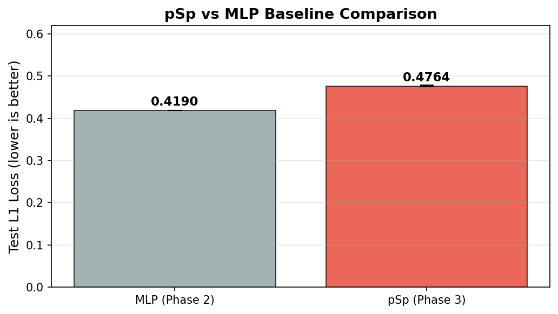
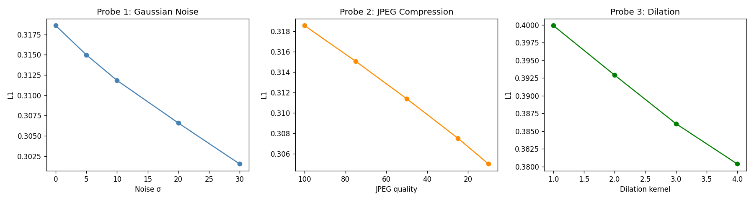
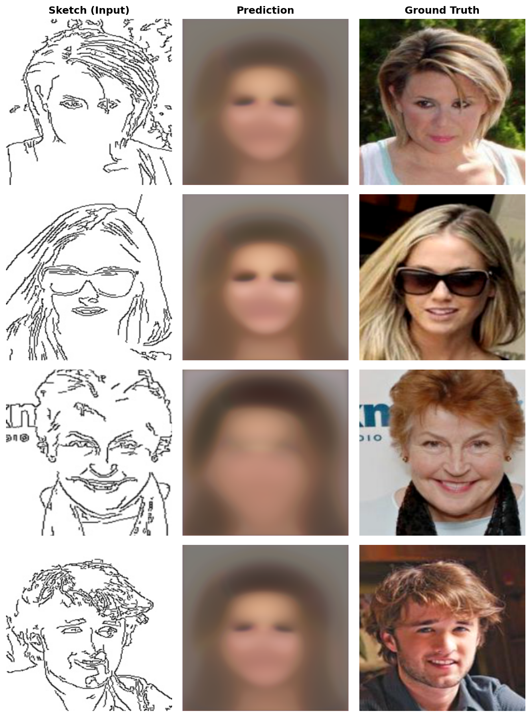
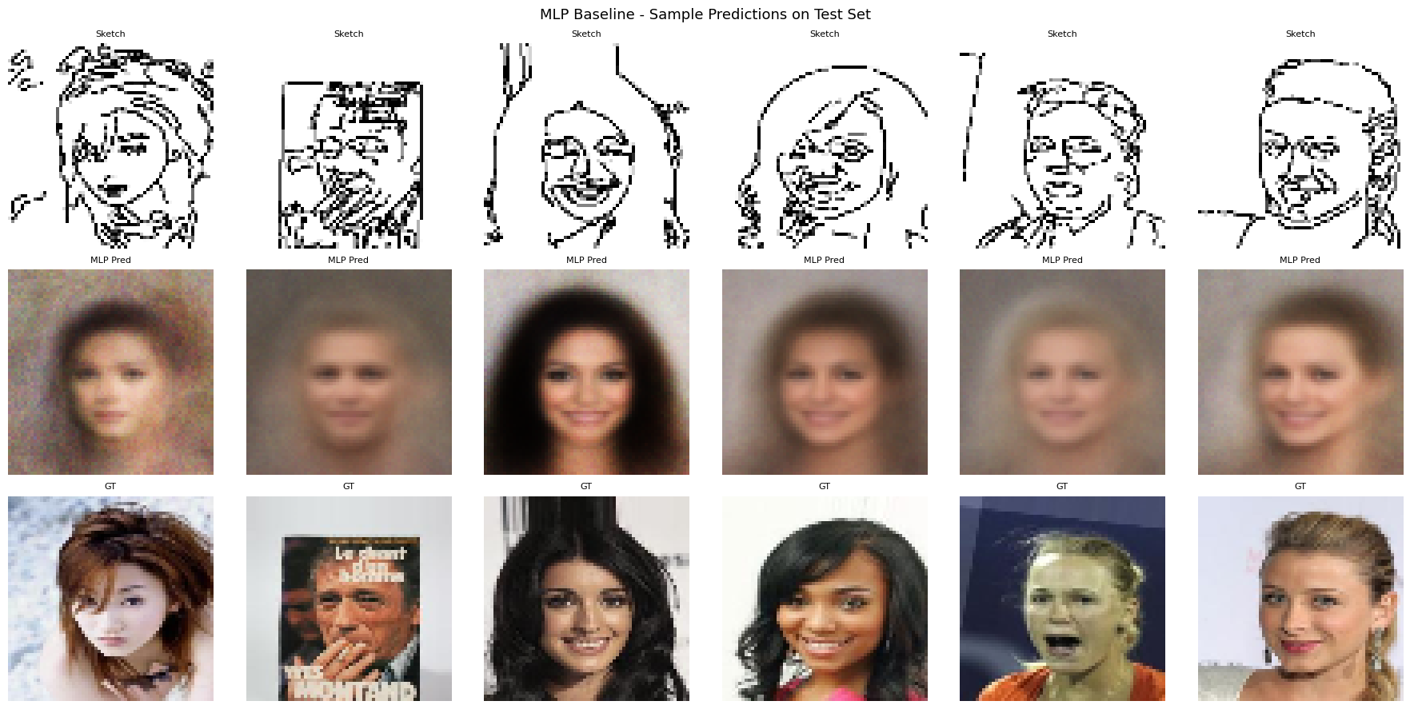
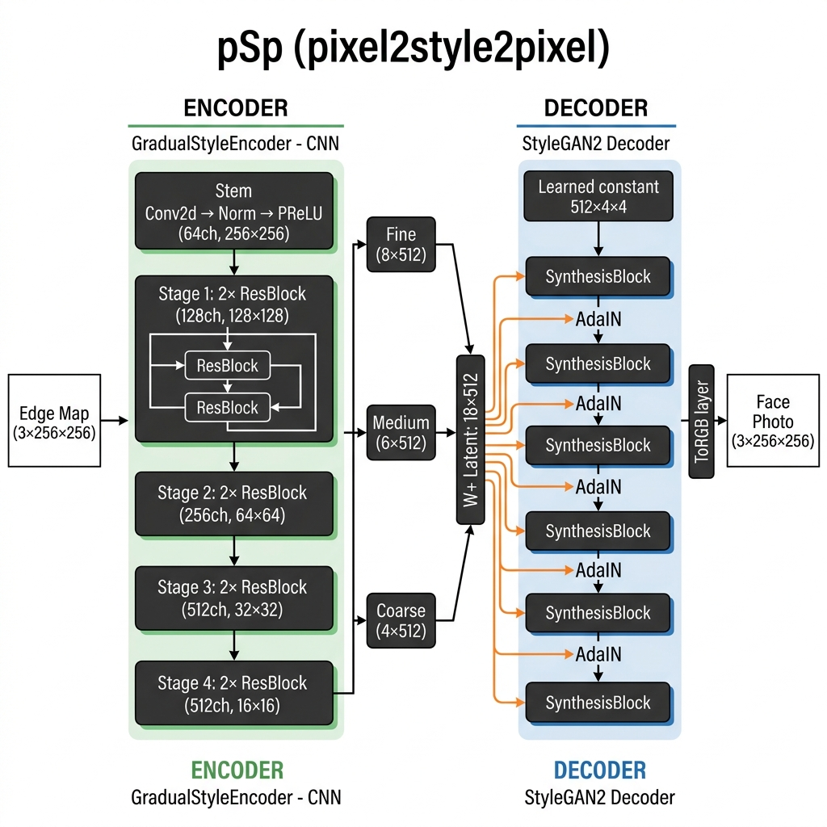
Phase 5 — Visualisations
Fig 6.1: Test L1 Comparison Bar Chart
Fig 6.2: Robustness Probe Line Charts
Fig 6.3: Qualitative Results Grid
Figure 3.1: Preprocessing Pipeline Diagram
Figure 4.2: pSp Architecture Diagram

Slide 19

6
PHASE 6
Final Pipeline & Deployment
Pix2Pix + CodeFormer Enhancement + Streamlit App

Slide 20
Phase 6 — Final Pipeline
1
2
3
4
5
📝
⚙
🖼
✨
🎯
Sketch
▶
Pix2Pix
▶
Generated
Face
▶
CodeFormer
▶
Enhanced
Face
Hand-drawn or
algorithmic edge map
cGAN
Conditional Generator
Raw GAN output
256×256
Blind Face
Restoration & Enhancement
Final high-quality
photorealistic output
CodeFormer provides blind face restoration — sharpening details lost during GAN synthesis and handling out-of-distribution inputs

Slide 21
Phase 6 — Deployment Architecture
CLIENT
API LAYER
MODEL
Streamlit Web UI
FastAPI Server
pix2pix
Sketch upload (PNG/JPEG)
POST /predict endpoint
Loaded once at startup
⟷
⟷
Load sample sketches
GET /health check
@st.cache_resource
Output face display
Input validation
model.eval() + no_grad()
About section (sidebar)
30s timeout + error messages
215.7 MB, 31.6 ms/img
🐳 Docker Containerisation: multi-stage Dockerfile + docker-compose.yml | Structured JSON logging | Config via ENV vars | GitHub CI/CD

Slide 22
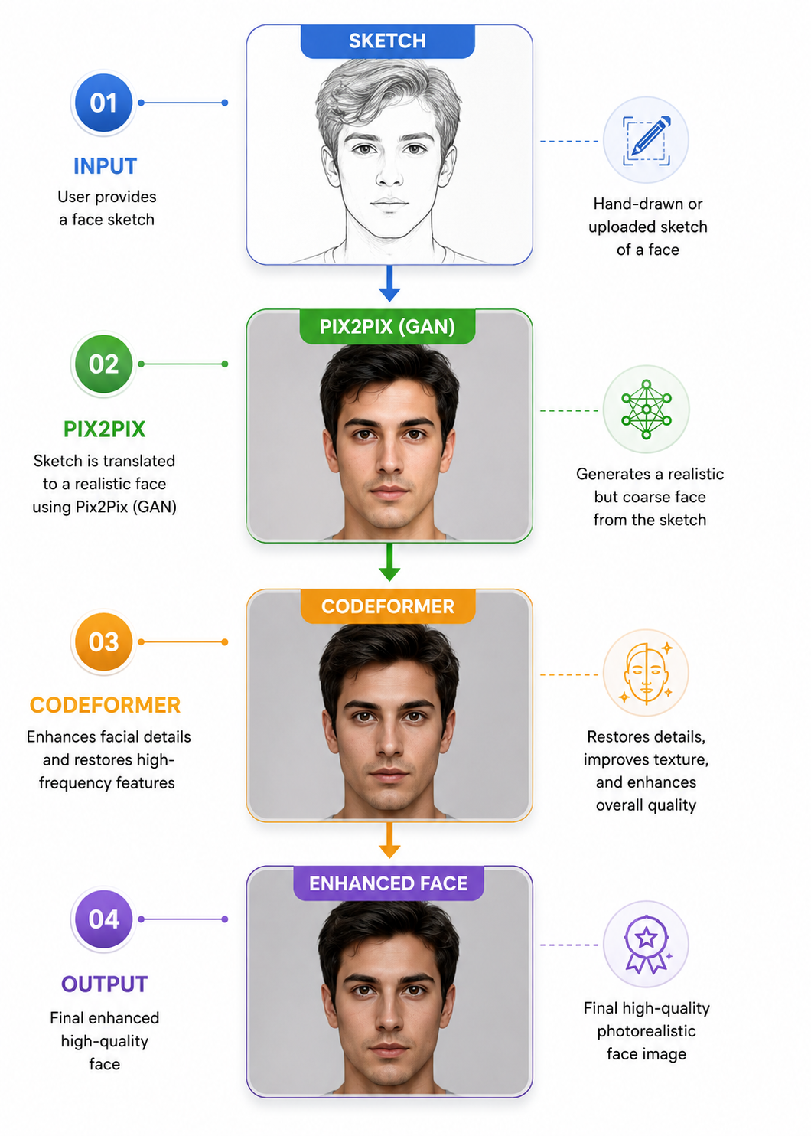
Phase 6 — Deployment Architecture Diagram

Slide 23
Discussion — Where It Works & Where It Fails
✓ Where the Model Succeeds
✗ Where the Model Fails
Near-frontal, well-lit, unoccluded faces matching CelebA distribution
Correctly captures gender and broad facial structure
Robust to Gaussian noise σ≤10 and JPEG quality ≥75
VAE latent space shows semantically meaningful face manifold
Smooth interpolation between face encodings → coherent intermediate faces
25.4% L1 improvement via ResNet-50 transfer learning
Heavy occlusion: sunglasses, hats, makeup — 83.3% of 30 worst predictions
Non-frontal poses and dark-contrast images consistently fail
Over-smoothing: L1-dominated training → blurry average-face outputs
Out-of-distribution sketches with high abstraction levels (very rough or artistic sketches)
Primary bottleneck: domain gap between algorithmic edge maps and true forensic hand-drawn sketches — the central unsolved challenge

Slide 24
Limitations & Ethical Considerations
⚠ Dataset Bias
✏ Sketch Authenticity
⏱ Compute Budget
25k filtered CelebA images — predominantly Western, light-skinned, frontal. Elevated L1 for male faces (0.3236 vs 0.3087 female), older faces (0.3241 vs 0.3120 younger), dark-contrast images.
Edge maps ≠ forensic sketches. Never trained or evaluated on CUFS. Direct CUFS input → identity collapse. Cannot be used for real forensic applications.
Fine-tune interrupted at 3,000/10,000 steps. HPO limited to 6/20 trials. Higher-resolution (512px, 1024px) not attempted.
❓ No Confidence Calibration
📊 Validity Threats
🛡 Deployment Risk
Single deterministic output with no uncertainty quantification. Cannot distinguish high-confidence vs out-of-distribution inputs.
L1 gameable by blurry average-face outputs. LPIPS should be primary metric. Test set drawn from same CelebA distribution — no OOD evaluation.
Must NOT be used in forensic/law enforcement contexts without extensive bias auditing across skin tone, age, gender, ethnicity.

Slide 25
Future Directions
01
02
03
Extended Training
CUFS Fine-Tuning
PatchGAN Discriminator
30–50 epochs with L1+LPIPS as joint training loss to address over-smoothing problem caused by training duration, not architecture.
Fine-tune ResNet-50 encoder on paired forensic sketch/photo data — most impactful single improvement targeting the domain gap.
Add 70×70 PatchGAN adversarial discriminator to force realistic local texture and reduce blurriness of L1-dominated outputs.
04
05
Adaptive Canny
Uncertainty Quantification
Replace fixed thresholds (50/150) with locally adaptive thresholds for improved edge extraction on low/high contrast inputs.
MC-dropout or deep ensemble to flag out-of-distribution inputs — required for any responsible high-stakes deployment.

Slide 26
Key Takeaways
Conclusion
ResNet-50 transfer learning with differential LR → 25.4% L1 improvement, statistically significant (p<0.0001, d=0.719)
F.normalize is a critical stability mechanism — removing it degrades performance by 65%
dropout_p is the dominant hyperparameter; primary risk is underfitting, not overfitting
Domain gap (edge maps vs. real forensic sketches) is the primary unsolved challenge
Deployed as a public Streamlit app with Docker containerisation and reproducible GitHub codebase
Moazzam Sharif • Bilal Asif • Muaz Ahmed | AI335L Deep Learning Lab | NASTP Institute of Information Technology | June 2026
github.com/BILAL-ASIF-github/Sketch-to-Face-Image-Synthesis

Slide 27
Team & Contributions
MS
BA
MA
Moazzam Sharif
Bilal Asif
Muaz Ahmed
S2024CS009 | Team Lead
S2024CS005 | Data Analyst
S2024CS016 | Testing & Deployment
Primary:
Primary:
Primary:
• Project architecture design
• CelebA dataset & preprocessing pipeline
• LSTM sketch-refiner & CNN edge enhancer
• U-Net generator & PatchGAN discriminator
• EDA notebook & augmentation code
• MLP baseline training (Ph 2)
• ResNet-50 transfer learning (Ph 3–4)
• Optuna HPO execution (Ph 4)
• FastAPI endpoint & Streamlit UI
• Documentation & final report
• FID/SSIM/LPIPS metrics
• Docker containerisation
• Presentation slides & GitHub structure
• Ablation study compilation & SRS (Ph 1)
• Robustness probe experiments (Ph 5)

